Slide 1
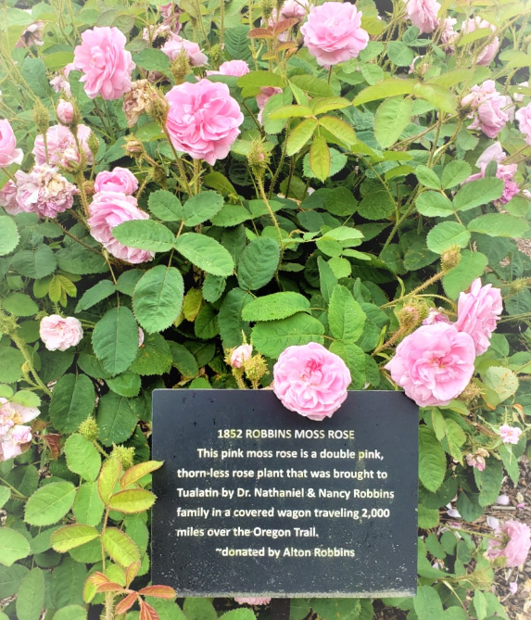
The Tualatin Historical Society’s
Report to Membership on the 2020/2021 fiscal year
This past year was rosier than we thought it could be…
…but there were still some thorns.
Historic Robbins Rose at Tualatin Heritage Center

Slide 2
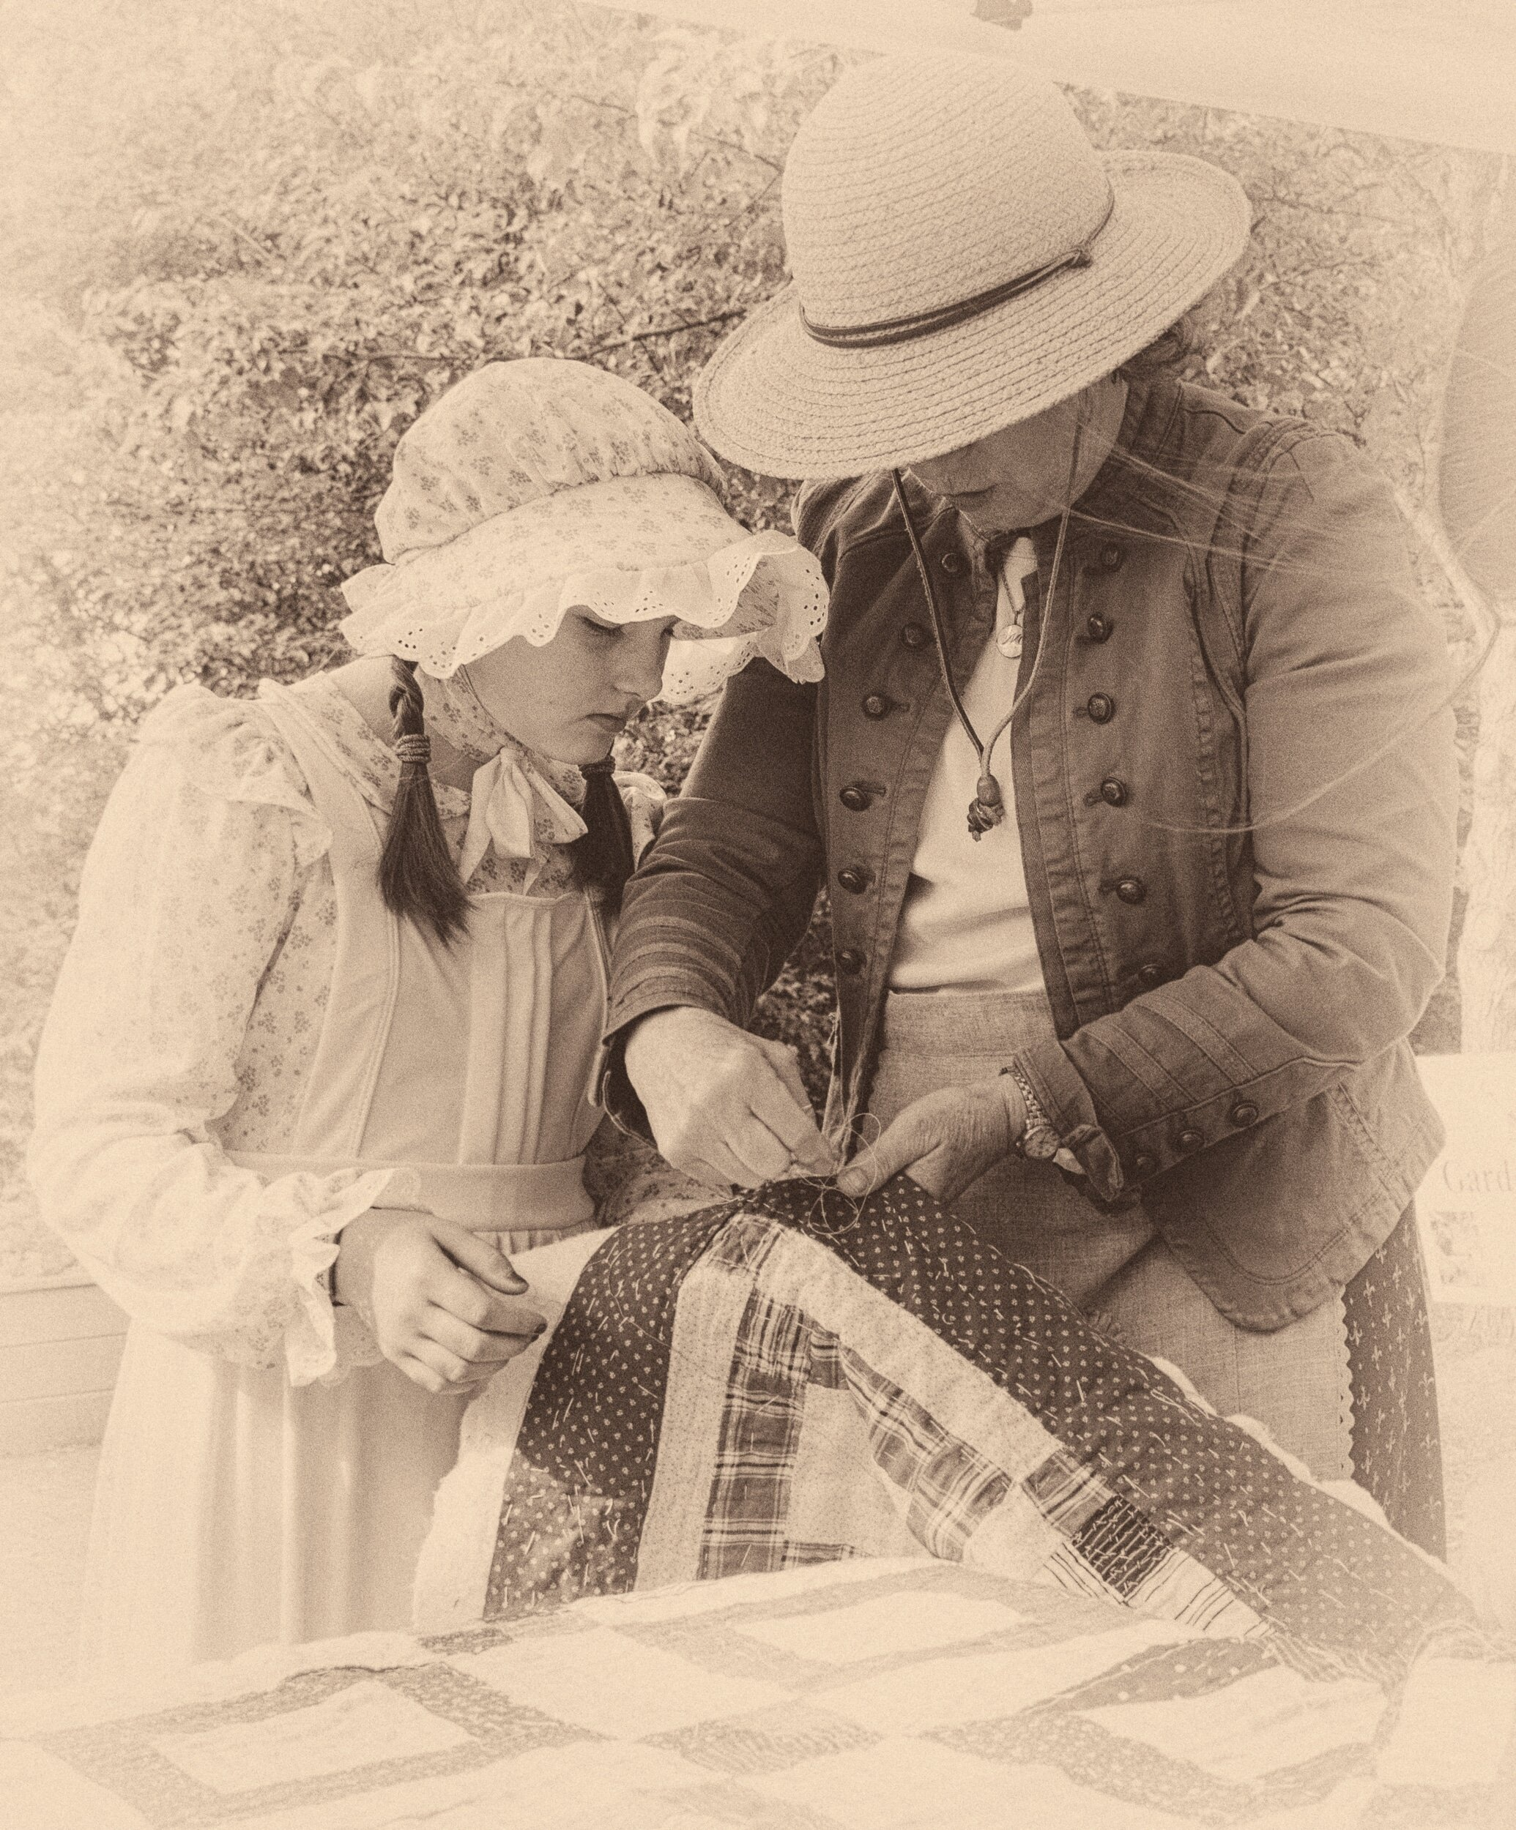
Learning on the fly with the pandemic
By the start of our fiscal year in July of 2020 we knew the pandemic, then a few months old in the US, was not going to quickly fade away.
We, of course, closed the Heritage center but kept Cindy busy with some projects noted in last year’s report.
Great programs planned by THS and our Ice Age partners had already been cancelled:
Latino Immigration in Washington County
Near Misses on the Lewis & Clark Expedition
Glaciers in Antarctica vs Ours
Collateral Results of Viet Nam
The Meaning of Climate Change
And… Perhaps the most tragic loss of all was our beloved Pioneer Days for 2nd year in a row.

Slide 3
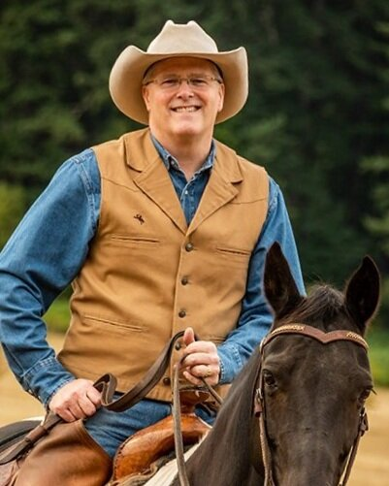
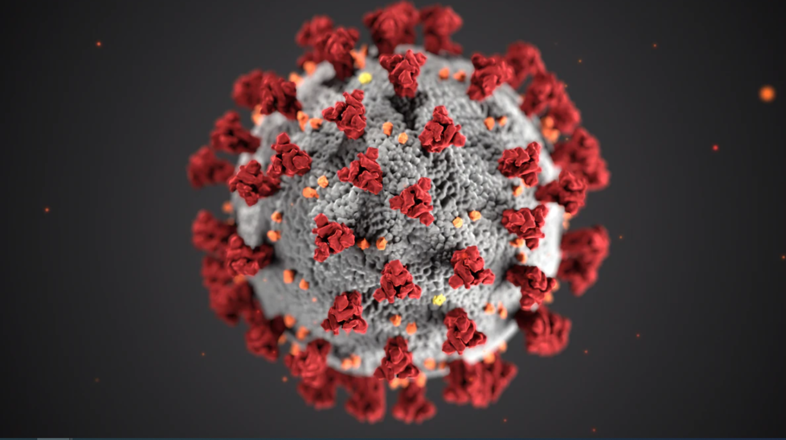
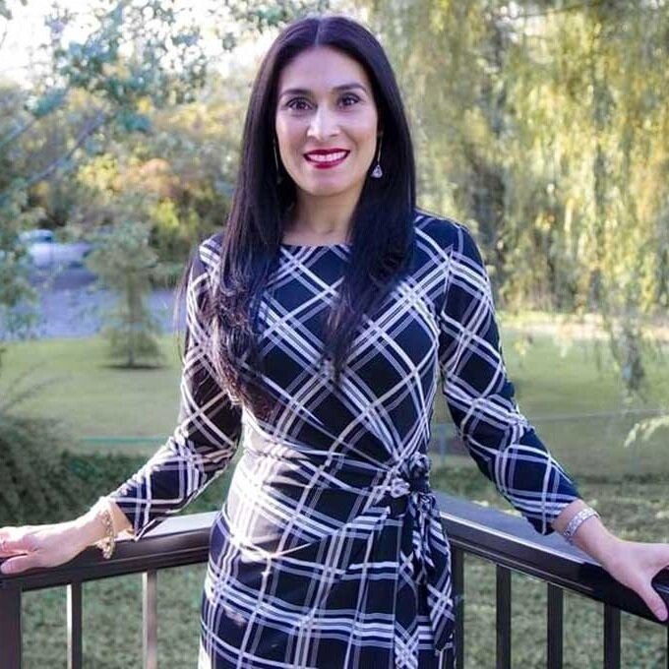
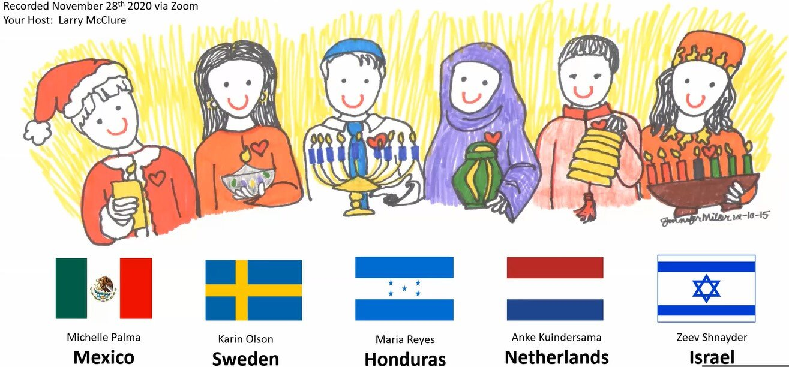
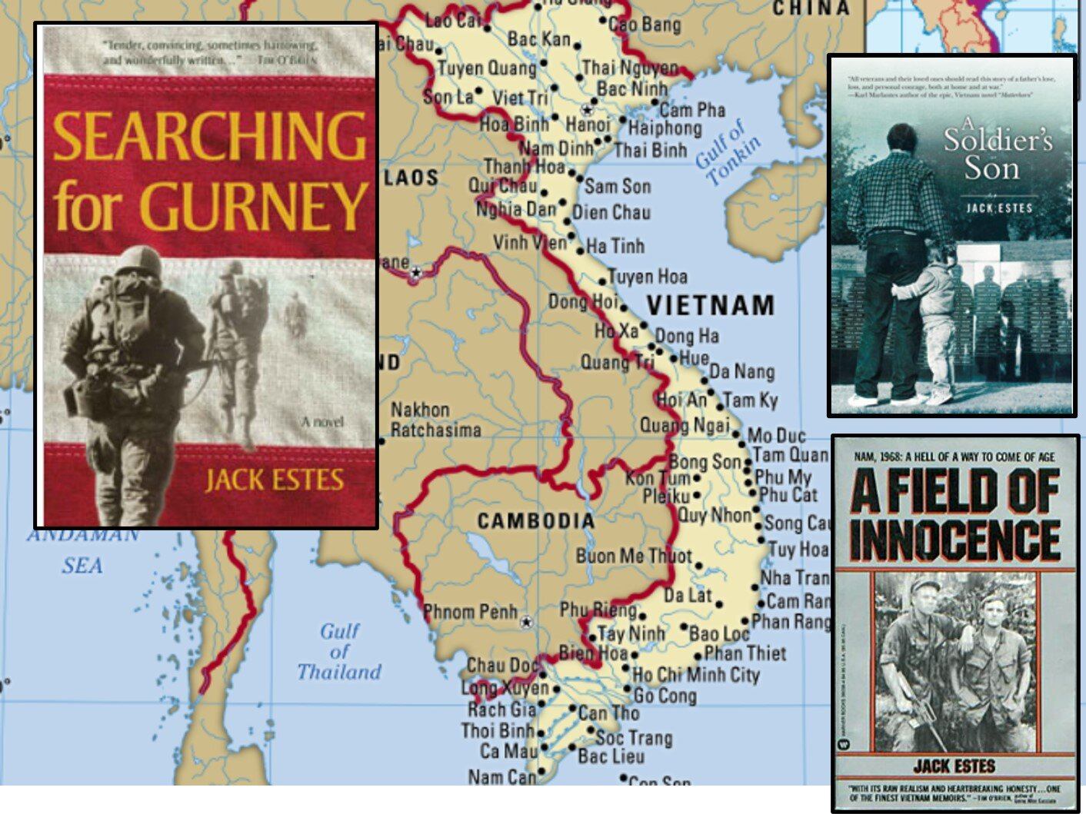
Still, after a few months of uncertainty, we did manage to put together a great batch of programs
The Short Beautiful Life of Interurban Transportation
Councilwoman Maria Reyes’ Incredible Journey
Artist Carlos Horcos Reflects on his Work for Tualatin and Other Commissions
Oregon’s Cowboy Poet Tom Swearingen
Holiday Traditions: Locally & from Afar
Bisons in your Backyard
Jonathan Crane’s Covid-19 Story
Scott Burns’ Majesty of the Swiss Alps
History of Hops on the Tualatin Plains
Vietnam vet Jack Estes author of Searching for Gurney.
Annual 4th of July Picnic (Food Truck)

Slide 4
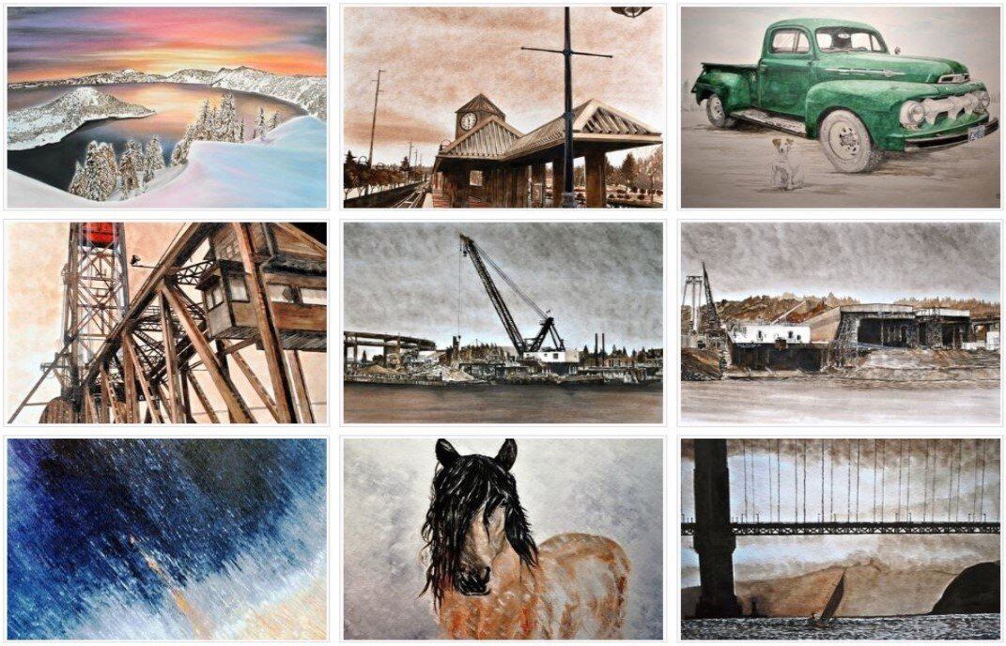
We are keeping busy. Here are some more things you should know.
Local artist Carlos Horcos wanted work with THS to identify projects consistent with our Mission Statement. As a result, he offered 3 custom watercolors for our Heritage Evening oral auction.
New home for the Lakeridge Rhyolite Glacial Rock.
The Center is open Mon-Fri 10-2. Rentals follow state/county guidelines.
We continue with oral histories. Most today are videos. All are born digital.
Harvesting our archives to populate the new web page continues.
Task forces to focus on volunteers, fundraising and archive management.
Our quarterly newsletter never missed a beat and is still issued regularly

Slide 5
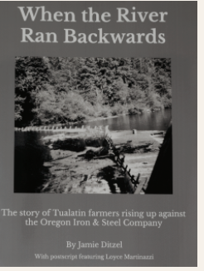
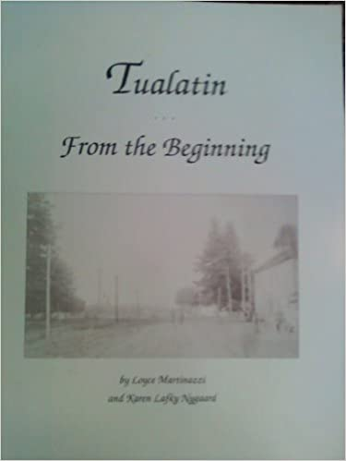
Two Books—so long in the making
PSU intern Jamie Ditzel has helped Loyce Martinazzi
keep a promise to her father: “Write that dam story!”
Learn about Tualatin farmers rising up against the
Oregon Iron & Steel Company. The names of the those who sought justice by blowing up the dam are finally revealed! When the River Ran Backwards is available in our store now.
Our bestselling book, Tualatin from the Beginning has long been considered the primer for anyone interested in really knowing the facts about our history. The 3rd edition is in final editing and will add 15 more years from where the 2nd edition left off!

Slide 6
Membership drive nets $7565 in dues
TOTAL MEMBERS: 246
Family Memberships 72
Individual 75
New Members 20
Deceased 3
Senior members (over 90) 19
Lifetime members 15
Honorary 20
Patron+Founders+Heritage Circle 28
During the membership drive we also received $735 in donations for the general fund and $910 for the Jack Broome Scholarship Fund for a total of $9210 in giving.
This past year we lost three members: Donna Scheckla, Evie Andrews and Art Barry

Slide 7
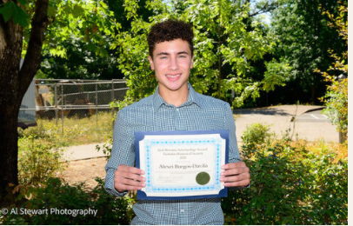
Winner of the 2021 Jack Broome Scholarship
The scholarship began in 2010 and was renamed last year in honor of Jack Broome. Jack was a great promoter of education and local history. He realized the historical society needs new and younger people to carry on in future generations. He insisted we must do our part in perpetuating the interest and belief of young people's involvement in history. Jack Broome passed away in June of 2020 at the age of 97. We renamed the scholarship to honor his major contribution to the community and particularly the historical society by naming the scholarship for him. An honor he surely would have not wanted, but we were compelled to do.
Alexei Burgos-Davila was the 2021 Jack Broome Scholarship recipient. He is a very talented, intelligent, and driven young man who will be successful in just about anything he chooses to do. He is a straight A student, attending OSU in Electrical and Computer Engineering.

Slide 8
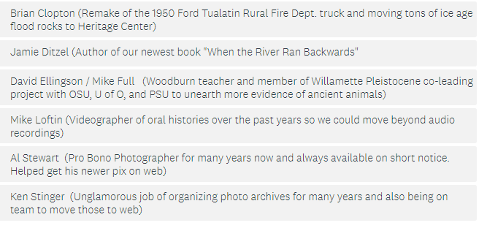
2021 Lafky-Martinazzi Award Nominees

Slide 9
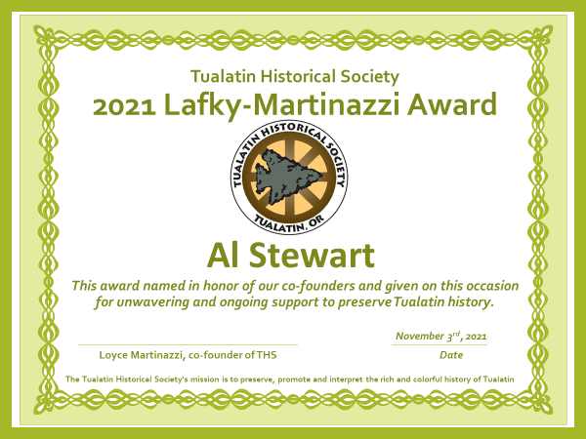
2021 Lafky-Martinazzi Award Winner

Slide 10
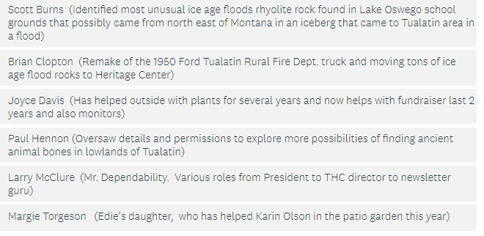
2021 Presidents Award Nominees
The President’s award is dedicated to those individuals or organizations who help promote the Society within our community and bring better awareness of our group, its programs and preservation efforts.

Slide 11
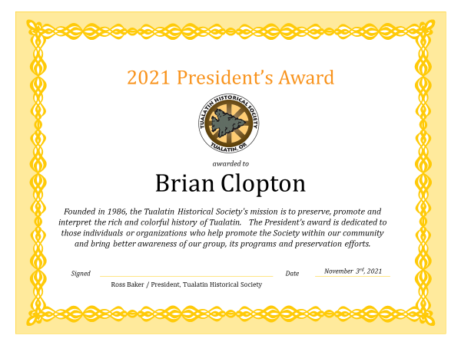
2021 Presidents Award Winner

Slide 12
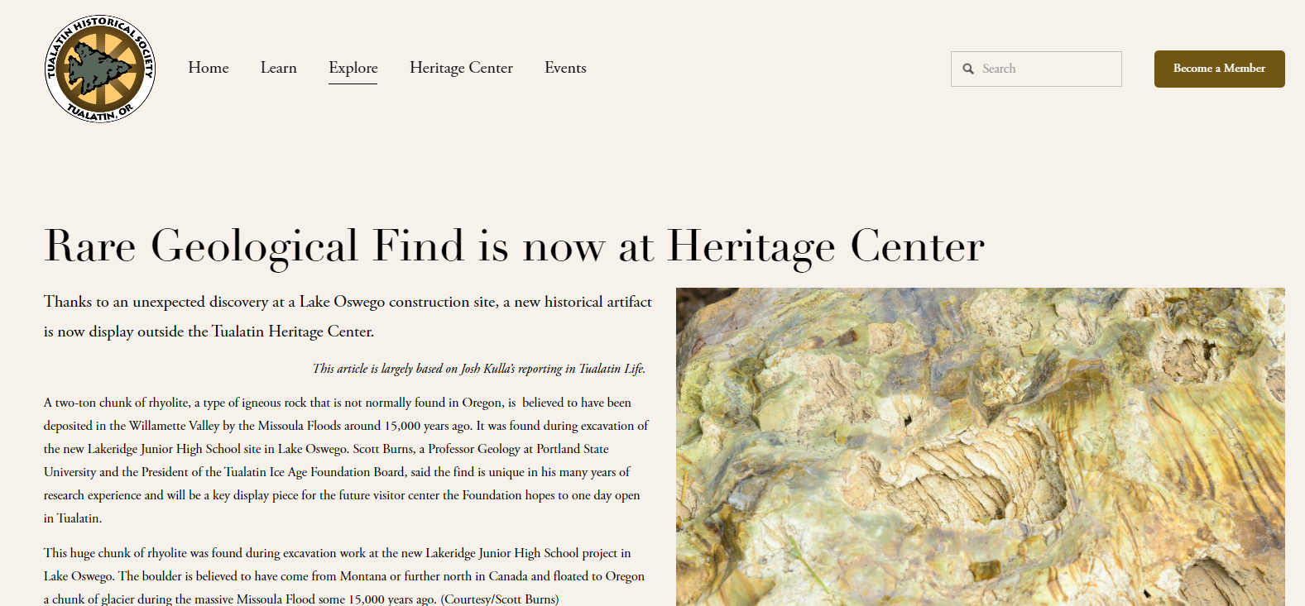
Our new web page: perhaps our biggest challenge during 2021, and something that brings us great pride.
All of the stuff you’d expect
Articles
Oral histories
Photos
Videos
Program information
Event calendar
And plenty you would not:
Interactive walking tour of Tualatin’s historic sites
Online store
Virtual tour of exhibits inside and outside of THC
Tualatin specific info like the Greenway Trail, Centennial Celebration, Park history and more
Digital Attic to find everything not yet on our page

Slide 13
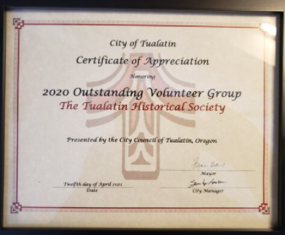
And of course…. Outstanding Volunteer group of the year in 2019 and shared honors in 2020.
"We are part of this city's success--one of America's top ten cities-- along with CIOs, School Administration, Responsive City Government, CenterCal support, etc… We facilitate Tualatin's continuing exceptional civic awareness, pride, and depth“
Art Sasaki
Board Member and
former President of THS
Award received in April 2021

Slide 14
Let’s play some Tualatin Trivia. Choice of gift: Bottle of wine or select from current books or jar of jam. All are true or false. We play until we have five winners.
1). ﻿Some early Tualatin residents were descendants of Davy Crockett.
(FALSE - But there were descendants of Daniel Boone. John Jesse Boone, a great-great grandson lived for a time in the Smith-Boone house that still sits next to the Sweek house)
2). Of the enormous evergreen trees that were cut down on donation land claims in the 1800s all were processed in local mills.
(FALSE - Some were so large and dense, hundreds of years old, that the local mills couldn’t handle them, and they were just hauled to piles and burned.)
3) The Robbins family came out on the Oregon Trail in the 1850’s and brought cuttings from a magnolia bush that still grow in Tualatin today.
(FALSE - They brought moss rose cuttings. Two of their rose bushes grow in the THC patio garden.)
4) In 1979, there was only one public school in Tualatin.
(TRUE - That was the old Tualatin Elementary on Boones Ferry Rd. That school was replaced by a new one on Avery rd. Several other schools have also been built since 1979: Bridgeport, Byrom, Hazelbrook, and Tualatin High School.)

Slide 15
Let’s play some Tualatin Trivia. Choice of gift: Bottle of wine or Select from current books or jar of jam. All are true or false. We play until we have five winners.
5) B.R. Henry was a Tualatin resident 1890-1910. He tried to build a plantation in Fiji, and later a plantation in Hawaii.
( TRUE - He did not succeed and remained in Tualatin the rest of his life)
6) Tualatin has only one Century Farm.
(TRUE - It is still owned by a Martinazzi family member, and has been in their extended family since 1869)….
7) Tualatin area farmers blew up a Tualatin River dam in 1906.
(TRUE - The farmers were frustrated and angry because the Oregon Iron & Steel Co. had raised the dam causing frequent flooding on several farms. The farmers had successfully won the decision in court to lower the dam, but nothing had been done about it for years.)
The first Tualatin Crawfish Festival was held in 1935.
( FALSE - It was held in 1951)

Slide 16
Let’s play some Tualatin Trivia. Choice of gift: Bottle of wine or Select from current books or jar of jam. All are true or false. We play until we have five winners.
9). In October of 1962, a terrific storm called Hurricane Freda, swept up the Willamette Valley causing much damage. It knocked so many ripe apples off the trees that local resident Clare OCallaghan called on neighbors to gather them and make “Freda Sauce”.
(TRUE)
10). During World War 2, only two Tualatin women, Dolores McLoughlin and Dorothy Ramsey served in the military.
( FALSE - 3 Tualatin women did. The 3rd was Pat Ladd She joined the WAVES, a division of the U.S. Navy. Dolores and Dorothy joined the Women’s Army Corps, or WACS.
11). Willowbrook Arts Camp has been held every summer since 1981 in Browns Ferry Park in Tualatin.
(FALSE - The first 10 years, the camp was held on the Sweek House property owned by ALthea Pratt-Broome, who started the camp.)
12). Yvonne Addington was the first female mayor of Tualatin.
(FALSE - She was the first city manager, serving from 1967 to 1982.)

Slide 17
Let’s play some Tualatin Trivia. Choice of gift: Bottle of wine or Select from current books or jar of jam. All are true or false. We play until we have five winners.
13). The Kalapuya Indian tribe, the first inhabitants of the Tualatin area, historically set frequent fires to their environment.
(TRUE - They did it to enable better harvesting and hunting of their food.)
14). Immigrants who arrived in the Oregon Territory in the early 1800s, were each granted up to 500 acres of land to homestead.
( FALSE. It was up to 320 acres.)
15). The oldest building in Tualatin is the 2-story brick building occupied by the VFW office, and Mashita’s Restaurant.
(FALSE - The oldest is the Sweek House, behind the railroad tracks at the corner of Tualatin Rd and Boones Ferry Rd. It was built in 1858 and is still a private residence.)
16). The Ki-a-Kuts Pedestrian Bridge, named after the 1850’s head of the Atfalati band of the Kalapuya Tribe, connects 3 community parks: Tualatin City Park, Tigard’s Cook Park, and Lake Oswego’s Waluga Park.
(FALSE - It connects the first two, and Durham City Park.)

Slide 18
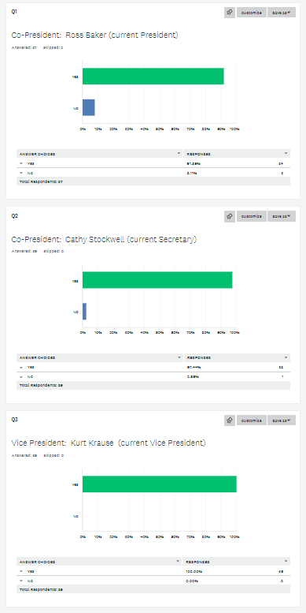
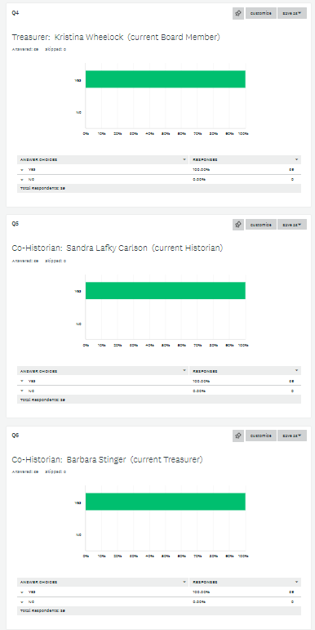
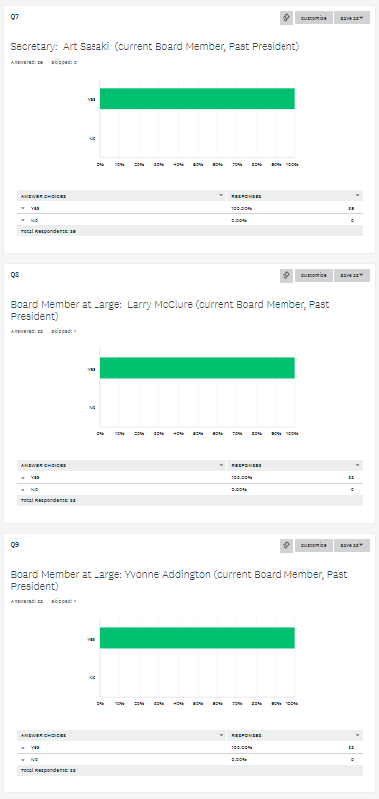
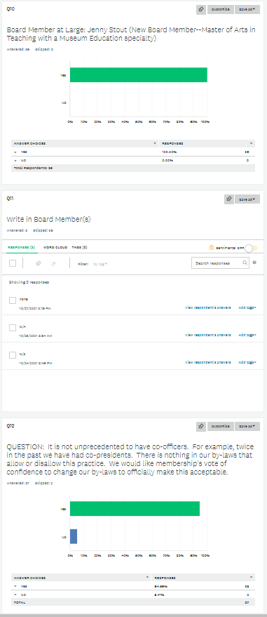
Election Results for 2022 Board All nominees received 91.7 to 100% yes votes. The question on co-officer positions received 95.6% yes votes.
Position Name % Yes
Co-President Ross Baker 91.7
Co-President Cathy Stockwell 98.0
Vice-President Kurt Krause 98.0
Treasurer Kristina Wheelock 100
Co-Historian Sandra Lafky Carlson 100
Co-Historian Barb Stinger 100
Secretary Art Sasaki 100
At Large Larry McClure 100
At Large Yvonne Addington 100
At Large Jenny Stout 100
Write-in Norm Parker N/A
Ballet measure Co-officer Okay? 95.6

Slide 19
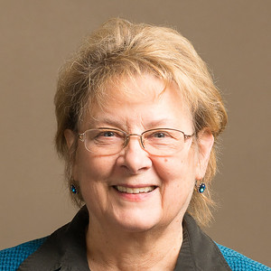
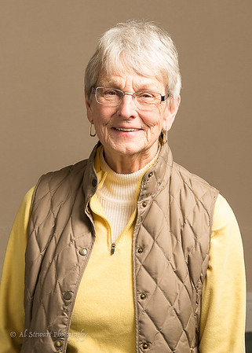
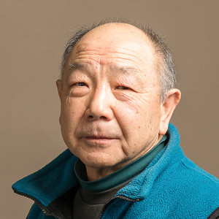
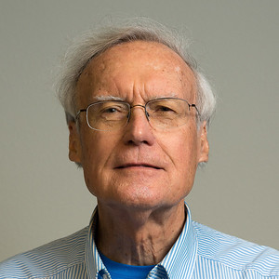
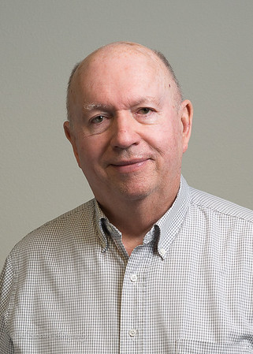
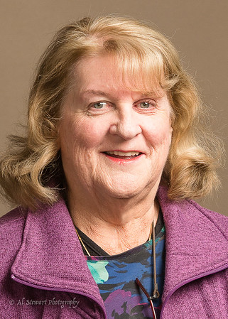
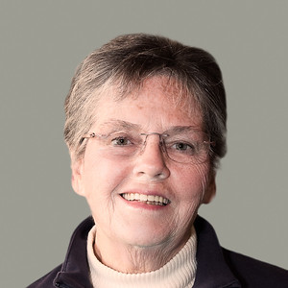
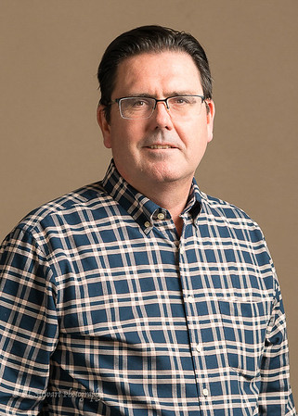
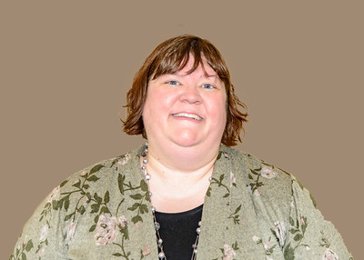
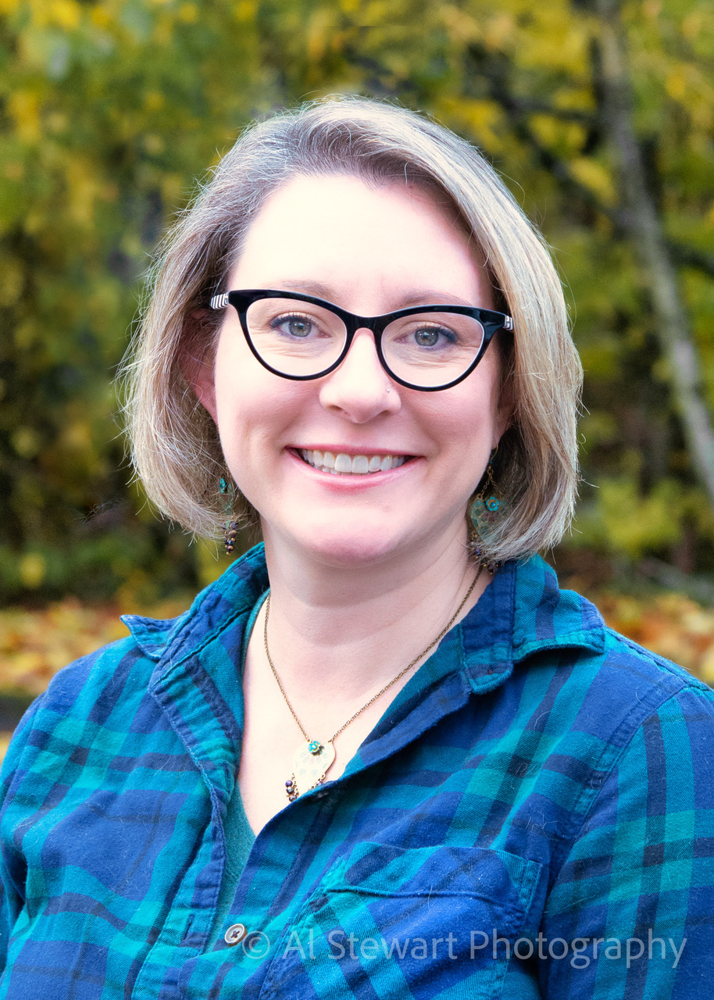
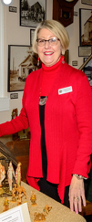
Your 2022 Board Members
Ross Baker, Co-President
Cathy Stockwell, Co-President
Kurt Krause, Vice President
Kristina Wheelock, Treasurer
Sandra Carlson, Co-Historian
Barbara Stinger, Co-Historian
Art Sasaki, Secretary
Yvonne Addington
Larry McClure
Jenny Stout
And our THC manager, Cindy Frost

